Slide 1
2025 CKCF Affiliate Summit- Reflecting on the Past and Looking Ahead
2015 flash flooding, Festus, MO
Cari Cullen
March 6th, 2025

Slide 2
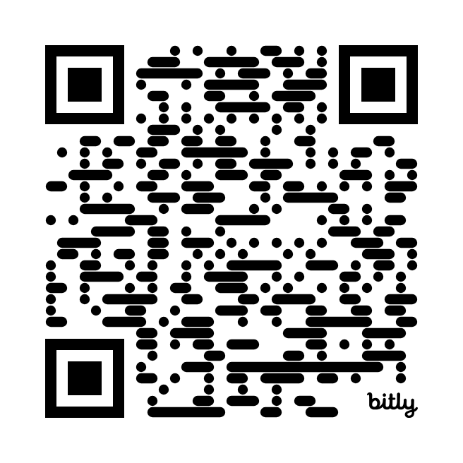
Today’s path
Role of the Community Foundation
Discussion
Case Study: A community foundations response
Resilience- Trauma Response

Slide 3
The Role of the Community Foundation in Disaster

Slide 4
OUR MISSION
We mobilize philanthropy to strengthen the ability of communities to withstand disasters and recover equitably when they occur.
OUR VISION
We envision a world where the impact of disasters is minimized by thoughtful, equitable and responsible recovery for all.
Notes:
Evergreen slide

Slide 5
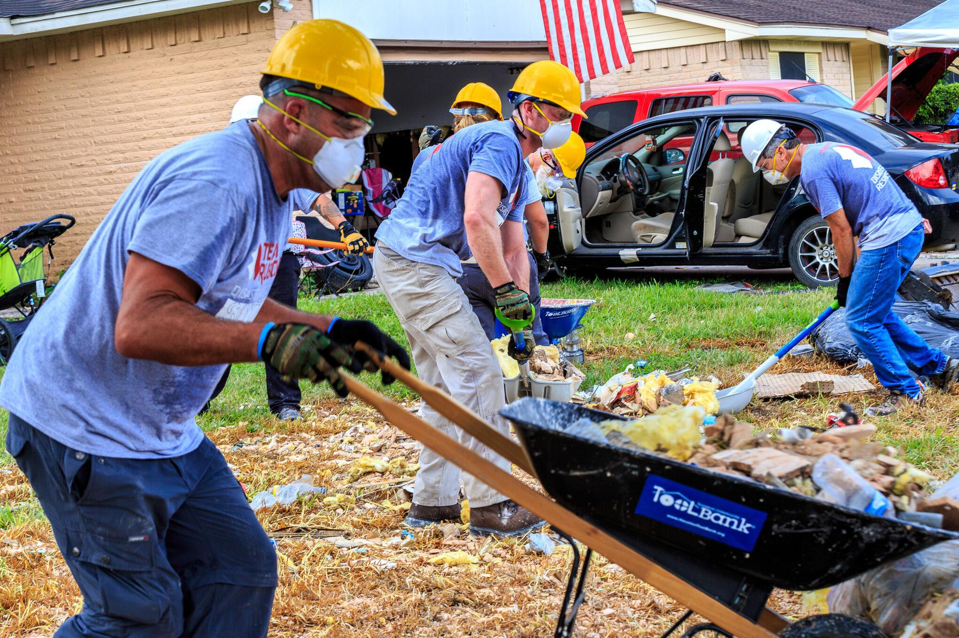
Who is CDP?
We are a philanthropic mobilizing organization. We seek to minimize the impact of disasters through:
Expert resources
Localized funding/grantmaking
Philanthropic expert advisory services
Notes:
Evergreen slide

Slide 6
Our Values
Integrity
Boldness & Innovation
Humility
Empathy
Ethical, accountable, transparent, trusting
Advocate, risk-taking, creative, courageous
Respectful, learning, self-reflecting, adaptive, partnerships, collaboration
Caring, thoughtful, attentive to language and images

Slide 7
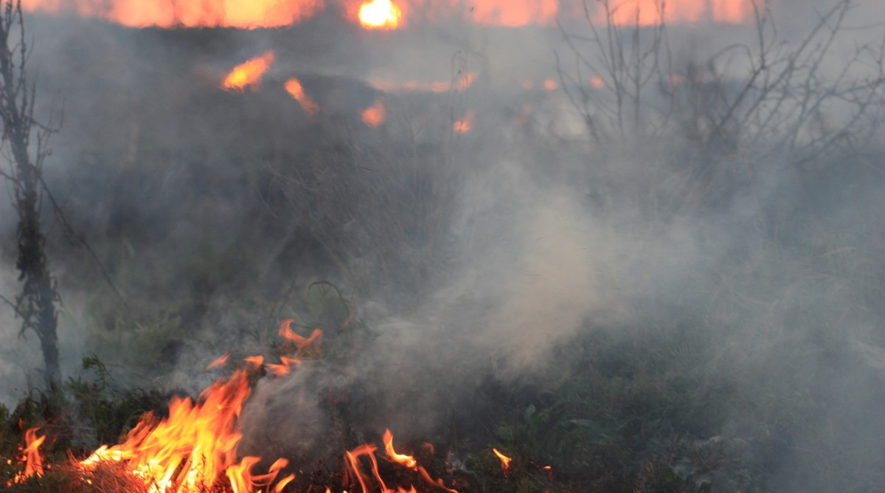
What is a disaster?
CDP uses a modified version of the UN Office for Disaster Risk Reduction definition:
“A disaster is a serious disruption of the functioning of a community or a society at any scale due to hazardous events interacting with conditions of exposure, vulnerability and capacity, leading to one or more of the following: human, material, economic and environmental losses and impacts.”
disasterphilanthropy.org/disasters/disasters-and-long-term-recovery/
Notes:
It’s in the definition – community/society, exposure, vulnerability, capacity are all related to humans and how we interact with the environment.

Slide 8
Hazard + Vulnerability = Disaster

Slide 9
What is a disaster?
Vulnerability
Hazard
Diseases and epidemics
Drought
Earthquake
Flooding
High winds (cyclone, hurricane, typhoon)
Landslide
Volcanic Eruption
War/conflict
Root Causes
Dynamic Pressure
Unsafe Conditions
Limited Access to:
Power
Structures
Resources
Lack of:
Local institutions
Training
Appropriate skills
Local investment
Local markets
Press freedom
Ethical standards in public life
Macro-forces
Rapid population growth
Rapid urbanization
Arms expenditure
Debt repayment schedules
Deforestation
Decline in soil productivity
Fragile Physical
Environment
Dangerous locations
Unprotected buildings and infrastructure
Fragile Local Economy
Livelihoods at risk
Low-income levels
Vulnerable Security
Special groups at risk
Lack of local institutions
Public Actions
Lack of disaster preparedness
Prevalence of endemic disease
Disaster
Vulnerability + Hazard
Notes:
Evergreen slide

Slide 10
What disruptions does disaster cause in community?
Housing
Multi-dimensional
Economy
Food Security
Education
Healthcare
Child care
Financial
Transportation
Access to resources
Insurance!
Legal issues
Political upheaval
Etc….
Mental Wellness

Slide 11
Challenges for recovery
Translate the highly complex system of disaster recovery into actionable steps.
Coordinate survivor information and ensure equitable distribution of resources from multiple agencies.
Identify and secure sufficient resources to address the unmet needs of those most vulnerable to the impact of disasters.
Develop and sustain mid- to long-term recovery efforts.

Slide 12
> 80% In 2017 and 2018, 1/3 of American households gave approximately $80/year, or $3 billion.
Hurricane Maria, Puerto Rico, 2017
Source: U.S. Air Force
Notes:
Tanya

Slide 13
In the U.S., disaster giving is quick and largely reactive. 1-4 weeks after a disaster = 1/3 of giving is completed. 1-2 months after a disaster = 2/3 of giving is completed. After 6 months: Almost all giving stops.
Yet recovery takes years . . .
Corporate giving is fastest!!
Notes:
Tanya

Slide 14
Notes:
Tanya
Key finding #2: Philanthropic support for disaster recovery and reconstruction is higher in 2022 compared to 2021. This is good news, but it is still not enough.
While response and relief still dominated this year’s giving, $201.8 million supported recovery and reconstruction in 2022, representing 11.6% of 2022 funding. Response and relief is still the biggest disaster strategy at $1.1 billion and 66.1% of the 2022 total. However, there was a decrease from 2021, when that strategy represented 82.4% of giving.

Slide 15
The disaster continuum and the “forgotten poles”
Disaster
5%
82%
5%
Funding for preparedness
Funding for long term
recovery
Funding for relief
Preparedness
Relief/response 6 weeks or less
Recovery 5-10 years

Slide 18
Community Foundations
Bridge
Conduit
Convener
Trust
Notes:
Bridge – government to community-based nonprofit and business Conduit – money, expertise and resources – and ATTENTION
Network-
Trust—provide the right information for the public, translate the system and set expectations

Slide 19
Building a playbook
During
After
Before
Ongoing

Slide 20
Before
Organizational Readiness
Disaster Ready Relationships
Personal & Community Preparedness
Planning for role in response and recovery
Pre-positioned funds
The resiliency of communities affected by disasters is often tightly linked to the resiliency of their nonprofit organizations, and organizations that can rebound and engage quickly contribute greatly to the community’s overall resiliency and recovery. Cameron Jones, TechSoup

Slide 21
During - Response
Needs assessment
Public information
Donations point
Outreach/support to nonprofit network
Fundraising
“CDP’s advice made a huge difference with organizations such as ours and other funders who said don’t spend all your money right away. Our hearts were so broken, it was hard not to give it all away. We’re in it for the long haul.” Kim DuFour, North Valley Community Foundation

Slide 22
After - Recovery
Community engagement – recovery priorities
Equity focus
Advocate and raise attention
Fund, coordinate and/or deliver services
Initially, I wasn’t sure if a convening role would work for the community, but the foundation served as a catalyst to make sure organizations weren’t duplicating efforts. In that role, we were able to work closely and quickly with area nonprofits to identify roles for our organizations to fill, whether it was serving families, children, nonprofit organizations or businesses. Holly Sampson, Duluth Superior Area Community Foundation

Slide 23
Ongoing
Risk awareness
Work to reduce vulnerability
Encourage and support personal, organizational and community preparedness
Support mitigation and adaptation efforts
Notes:
– Integrate risk (climate and weather) into housing development, workforce development…etc.

Slide 24
Tools, Templates and Resources - Preparedness
1
2
3
Personal Preparedness
COOP/EOP Plans
Funders Specific
Home Emergency Preparedness Checklist (EDEN)
Ready.gov
Recovery After Disaster: The Family Financial Toolkit (MN Extension)
RCRC Toolbox (National Center for Disaster Preparedness (NCDP) & SAVE the Children)
Disaster Planning and Recovery Guide (TechSoup) – IT focused
Continuity of Operations Guidebook and Template for Nonprofit Service Providers (SJSU)
Disaster Philanthropy Playbook (CDP)
Basic Tips for Disaster Giving (CDP)
Disaster Philanthropy Toolkit (Iowa Council of Foundations)

Slide 25
Discussion

Slide 26
Discussion
Example of a recent disaster that impacted a community in your service area (COVID-19 works if there isn’t another example that comes to mind). What did you learn? How did you support the impacted community? What would you do differently next time?
How has your organization worked with communities to prepare and/or recover from disasters? Reflecting on the conversations we’ve had about the role community foundations can take in disaster, what is one idea you will take back with you to explore for further action?

Slide 27
Case Study: A community foundations response

Slide 28
Flooding
Wildfire
High-wind event (tornado, derecho)
Winter-storm
Acute pollution
Excessive heat with power-outage
What scale/considerations of impact and disruption would this type of hazard need to reach for your organization to respond? At what level do you think you could respond if it happened today?
Imagine that you know a this will occur one year from now and significantly affect 50% of the households in your service area. You have $25,000 to help you prepare but you can only tell one other person about it. What will you do? How will you prepare your organization? Your community?

Slide 29
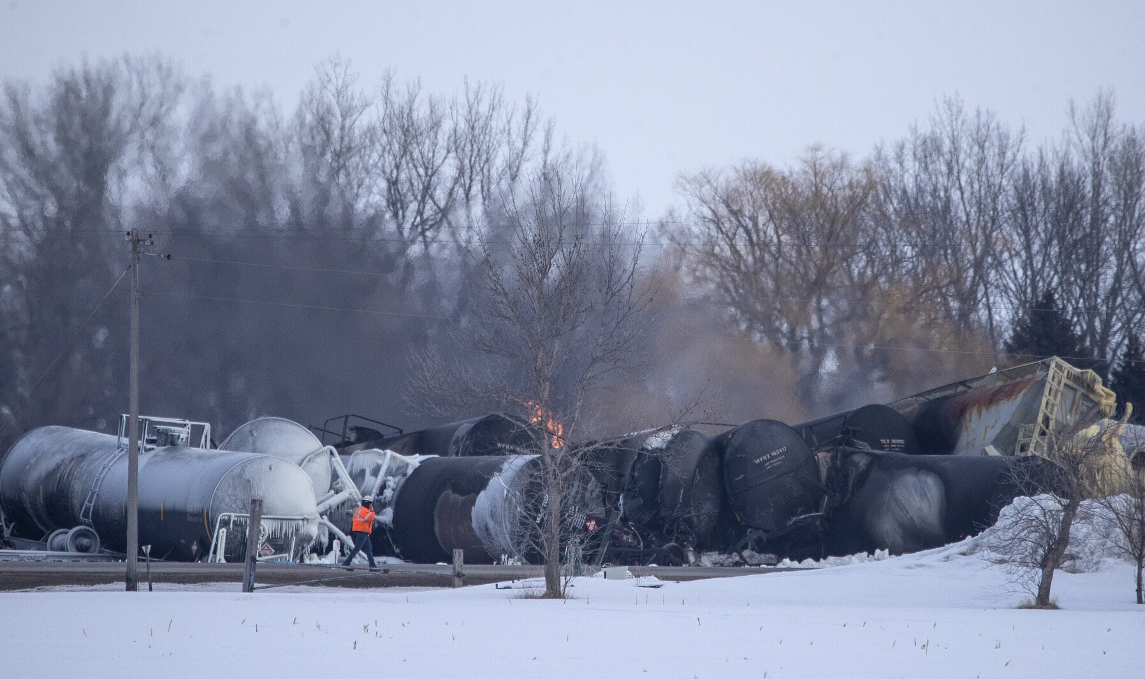
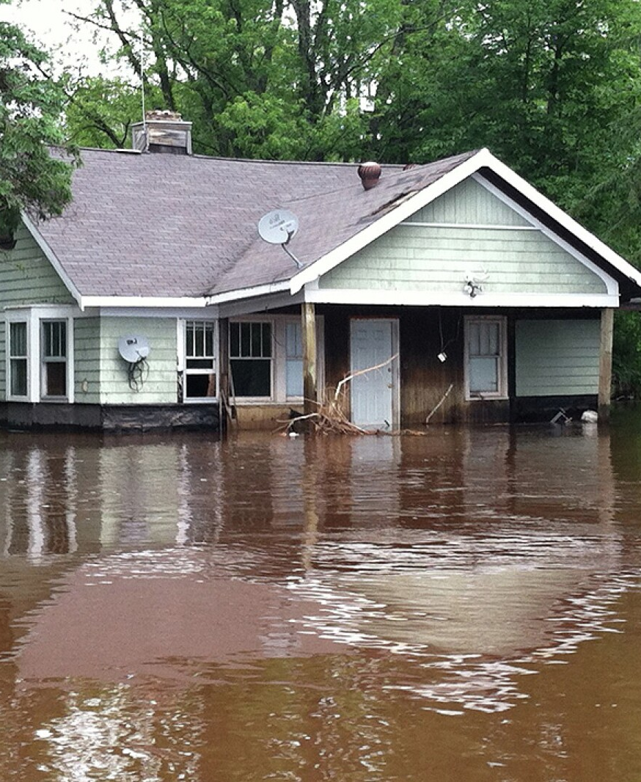

Slide 30
Resilience and Trauma-Responses

Slide 31
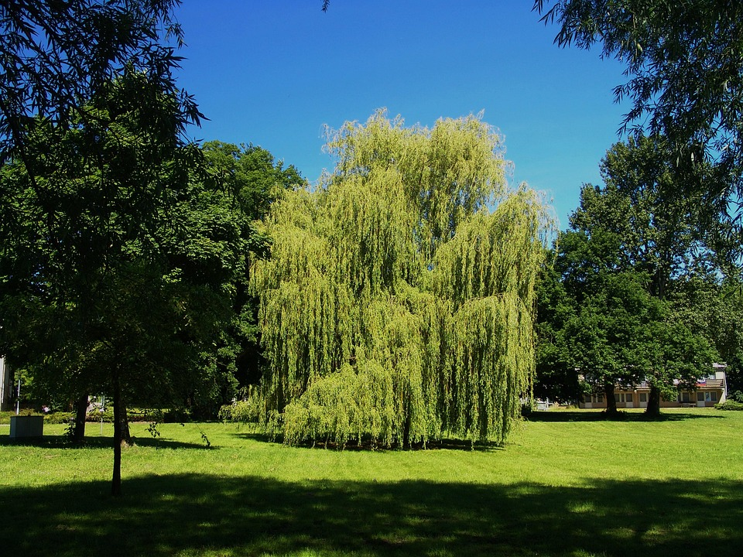
This Photo by Unknown Author is licensed under CC BY-SA-NC
Notes:
Kintsugi
Resilience is not what happens to you. It’s how you react to, respond to, and recovery from what happens to you.’ Jeffrey Gitomer
Ascribing resilience to others is not an excuse.

Slide 32
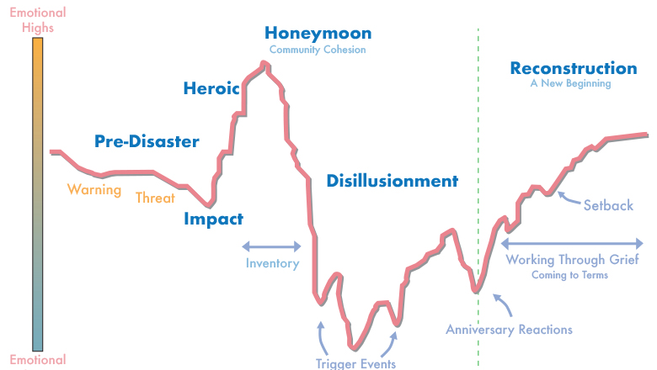

Slide 33
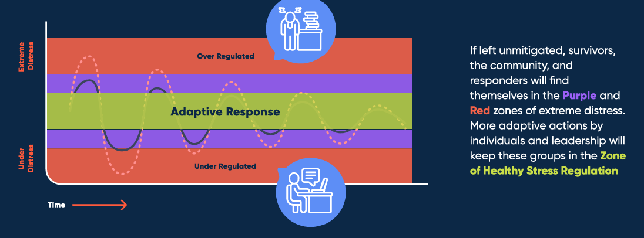
Model for Adaptive Response to Complex Cyclical Disasters
Notes:
Higher risk groups are likely to experience disaster differently than the general population. These groups are likely to be both disproportionately negatively impacted and experience inequity in aid and response. Higher risk groups include underrepresented communities such as racial minorities (such as Black, Indigenous communities, Asian, Pacific Islander, Latinx), religious minorities, ethnic minorities, people with disabilities, the LGBTQ+ community, people with low income, people residing in rural and remote areas, refugees/displaced communities, and others. Community leaders and responders must identify and assess these higher risk groups to ensure more equitable response.

Slide 34
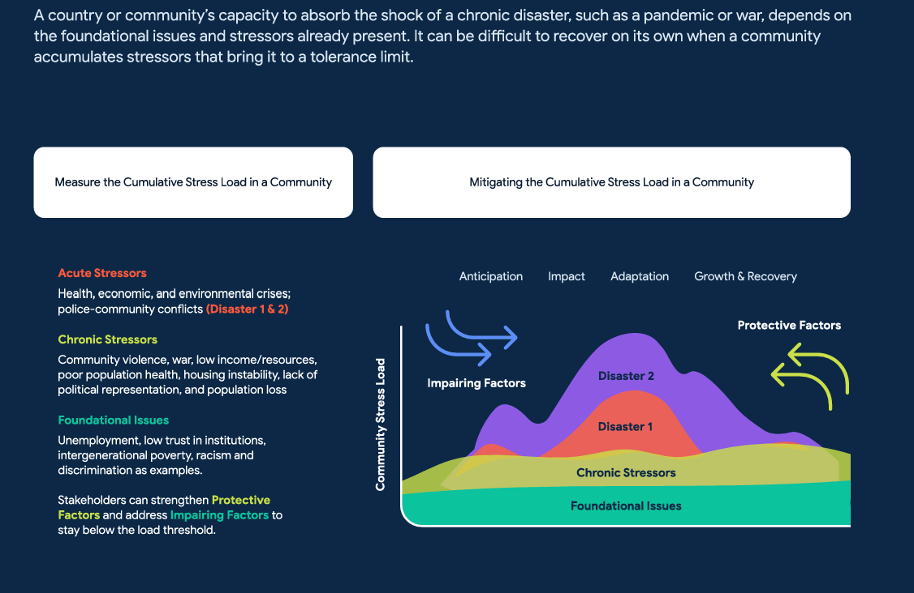

Slide 35
BREATHE
From Hummingly: Cards for Calamity

Slide 36
Closing - Photo
A normal reaction to an abnormal event.
Whole people: disasters may have physical, emotional, spiritual, social impacts on individuals.
You don’t have to be “directly” impacted to have a emotional response.
Not having a response is also okay.
Grief is not linear or cyclical.
Not everyone needs licensed, professional intervention but some do, and it should be available/accessible to all.
Seek help if the challenges of acute stress are ongoing or coping strategies are leading to long-term unhealthy patterns.
Growth and Adaptation after disaster is possible, but it takes time and longer than anyone wants.
This Photo by Unknown Author is licensed under CC BY

Slide 37
Tools, Templates and Resources – Spiritual & Emotional Care
1
2
3
Trainings
Websites & Tipsheets
Funding in Disaster
Psychological First Aid (PFA)
Training | Crisis Care Ministries, LLC
Emotional and Spiritual Care in Disasters (ICISF)
hummingly.co/collections/services-products
DISASTER SPIRITUAL CARE and DISASTER EMOTIONAL CARE GUIDELINES (NVOAD)
Vibrant Emotional Health
Resources - Child Life Disaster Relief
Emotional Recovery | Disaster Relief | Red Cross
Mental Health, Grief and Bereavement - Center for Disaster Philanthropy
Mental Health and Trauma - Center for Disaster Philanthropy
Disaster Distress Helpline: 1-800-985-5990

Slide 38
Expert Resources
Special Reports
Measuring the State of Disaster Philanthropy
Covid-19 and Philanthropy
U.S. Household Disaster Giving Report
Disaster Philanthropy Playbook
Website
Blogs, Issue Insights, Disaster Profiles, Weekly Disaster Updates
CDP Staff
Speaking engagements, Analyses, Opinion Pieces, Consulting Services
Webinars
disasterphilanthropy.org
Notes:
Evergreen slide

Slide 39
Thank you.
Cari Cullen cari.cullen@disasterphilanthropy.org

