Slide 1
Planned Giving: When that is not all that you do
J. Michael Lamb, EMBA, CFRE (Ret.)
Planned Giving Consultant

Slide 2
What You Are Thinking
Planned giving is too complicated.
We need money now and don’t have time for planned giving.
I don’t know how to identify planned gift donors.
I don’t know how to solicit a planned gift.
Planned gifts take too long to “mature.”
I’m not an attorney or accountant, so I can’t discuss planned giving.
Planned gifts compete for outright gifts.
Our donor pool is not rich enough to make planned gift commitments.
Most planned gifts are revocable. Why waste the time?
We cannot afford a complicated planned gift marketing program.
I’m not comfortable with planned giving because it involves talking about death.

Slide 3
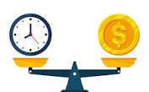
Why invest time and money in planned giving ?

Slide 4
Why invest time and money in planned giving ?
Average U.S Charitable Planned Gift=
$50,000

Slide 5
Planned Giving in Context
Planned
Major
Annual

Slide 6
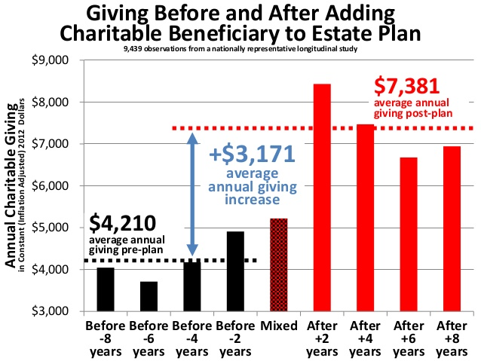
Impact of Planned Giving on Outright Giving
*James

Slide 7
Planned Gifts by Type

Slide 8
Bequest (Will or Trust)
Bequest Benefits
Revocable
Can be modified
Will- Codicil
Trust- Amendment
Donor designated purpose
Modest expense
Will- $1,000
Trust- $3,000
Can disclaim

Slide 9
Bequest Types
Specific (Dollar amount, personal property, real estate)
Suggested language-
“I hereby give, devise and bequeath (dollar amount or property or real estate description) to the Central Kansas Community Foundation, a nonprofit organization located at 400 S. Main St. #100, Newton, KS, 67114, Federal Tax ID #00-1234567, for the general use and purpose of the organization.”
Percentage
Residual
Contingent

Slide 10
Beneficiary Designations
Qualified Retirement Plans
401(k)
403(b) (nonprofit version of 401(k) )
IRA
Life Insurance

Slide 11
Beneficiary Designation Benefits
Retirement Plans
Revocable
Free and easy to implement
Donor remains in control of the assets
Tax avoidance
One-third of wealth is the U.S. is held by qualified retirement plans

Slide 12
IRA Considerations
Required Minimum Distribution at age 73
For IRA only, donor can make a Qualified Charitable Distribution at age 70 ½
QCD can meet the RMD
Donor can give up to $108,000 in 2025 to one or multiple nonprofits
QCD is tax neutral- not taxable income and no tax deduction
If you receive a QCD, the donor has self-identified that they have an IRA and that they are charitably inclined, e.g. planned giving prospect

Slide 13
Life Insurance
Leverages relatively modest investment in premiums toward a larger death benefit
Option for donor to gift new or existing, but no longer needed policy
Term vs Permanent policies
Nonprofit as owner vs beneficiary
Ownership requires maintenance, e.g. valuation of death benefit and cash surrender value
Gift of ownership of paid-up policy
Donor tax deduction limited to lessor of basis or replacement cost
Gift of ownership of partially paid-up policy
Requires ongoing premium payments
Donor tax deduction is the “interpolated terminal reserve”, roughly the cash surrender value.

Slide 14
Charitable Gift Annuity
Simple contract through which the donor receives fixed income payments for life in exchange for charitable gift of cash or appreciated securities.
Initial gift is tax deductible. CGA payments are partially tax deductible
CGA rate is based on donor age using actuarial tables of life expectancy (American Council on Gift Annuities). Rate for donor age 75 is 7.0%. Rates set so that approximately half of the initial gift will remain for the nonprofit benefit at the death of the donor.
ACGA- (acga-web.org )
Requires ongoing management of donor payments and tax reports.
CGA program management
Everence Foundation
National Gift Annuity Foundation ( nationalgiftannuity.org )

Slide 15
Other- POD and TOD
Payable on Death- Bank accounts
Transferable on Death- Brokerage accounts, real property, real estate*

Slide 16
Planning Disconnect
Percent engage in outright charitable giving
Percent make provisions for a charitable planned gift

Slide 17
What do These People Have in Common?
Pablo Picasso
Prince
Sonny Bono
Aretha Franklin
Michael Jackson
Howard Hughes
Abraham Lincoln

Slide 18
U.S. Population Over Age 50

Slide 19
Donor Behavior

Slide 20
Planned Giving Perspectives
You mean 90% of our donors will die without leaving a gift?
You mean we could generate 9 times more estate gifts from our current donors?

Slide 21
Reality of Mortality
Regardless of the terminology or packaging,
estate planning is planning for one’s own death.

Slide 22
Good intentions
What we say:
What they hear:
Seminar Tonight About:
Your Upcoming
Death
Seminar Tonight About:
Estate Planning

Slide 23
Death as a problem or opportunity
Problem
Avoidance
I will deal with this later.
This doesn’t apply to me.
Opportunity
Symbolic immortality
Legacy
Passing on what is important to us
Planned Gift

Slide 24
Mortality Avoidance & Solutions
Confidentiality
Complexity
Cost
Control
Children

Slide 25
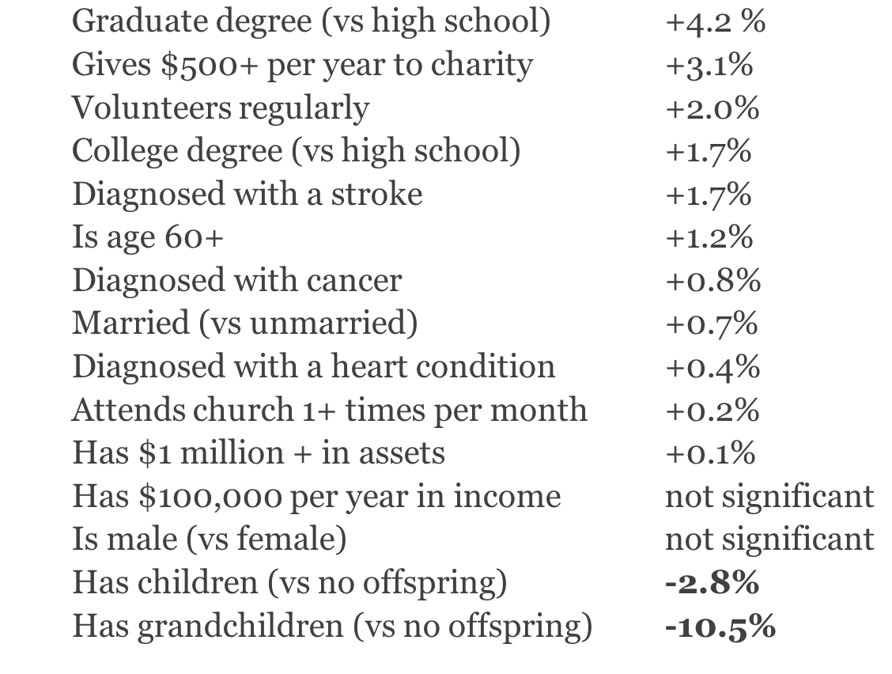
Prospects
Likelihood of having a charitable plan, persons age 50+ (James)

Slide 26
Avoidance Breakthrough
Illness
Injury
Advancing age
Death of a family member/close friend
Divorce or marriage
Retirement
Travel plans

Slide 27
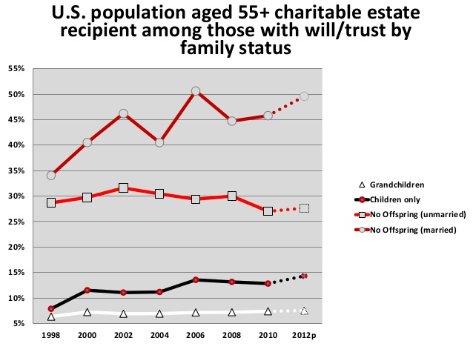

Slide 28
Planned Giving Prospects
Age 55+ initial plans and age 75+ revised plans
15+ outright gifts (frequency)
Giving in 7 out of the past 10 years (recency)
Event attendees & volunteers, esp. Board (engagement)
A strong predictor of charitable estate planning is childlessness (which we only discover anecdotally)
IRA outright charitable distribution
Charitably inclined
Retirement plan that has a remainder beneficiary

Slide 29
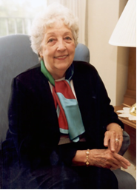
Used inherited assets to create a scholarship in honor of her sister
“I never knew the privilege and pleasure of making this type of gift.”
– Emylou
Emylou

Slide 30
Marketing Focus
Stories about living bequest donors are more influential vs. stories about deceased bequest donors (avoid death reminders).
Two check boxes on every pledge card.
Include planned giving reference in every communication possible.
Avoid technical language
Make a gift through your will to WF vs Make a bequest through your will to WF
Suzanne & Doug Coin

Slide 31
Messaging
Some of our donors have decided to extend their support with a gift through their Will. *Planned giving as a social activity done by others.
Have you considered extending your support by including a gift to the community foundation in your Will ?
What experiences would you like to perpetuate ?
What would you like to accomplish with your money that would be meaningful to you and impactful for our community ?

Slide 32
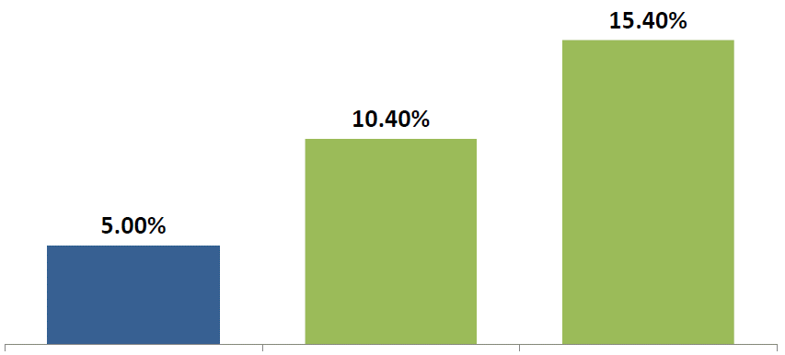
Planned Giving-
Words Matter
Charitable plans among
1,000 testators
Charitable plans among
1,000 testators
Charitable plans among
1,000 testators
No reference to charity
Would you like to leave any money to charity in your will?
Many of our customers like to leave money to charity in their will. Are there any causes you’re passionate about?
*Slide credit to Professor Russell James

Slide 33
What About Taxes ?
Federal Estate Tax Threshold 2024: $13.99 million (individual)
$27.98 million (couple)
Only 0.2% of estates are subject to estate tax.

Slide 34
Planned Giving Advisory Council
Attorney
Trust Officer
Life Insurance Agent
Financial Planner
Benefits

Slide 35
Documentation
Secure the gift
Document the purpose
Basis for ongoing stewardship
Revocable
Legacy Society
Keep on hand !

Slide 36
Resources
National Assoc. of Charitable Gift Planners- Charitablegiftplanners.org
Association of Fundraising Professionals- Afpglobal.org
Russell James- Encouragegenerosity.com
Crescendo- Crescendointeractive.com
Advancement Resources- Advancementresources.org
“The Art and Science of Donor Development”- Donor cultivation & solicitation
Stelter- Stelter.com

Slide 37
“The true meaning of life is to
plant trees under whose shade
you do not expect to sit.”
- Nelson Henderson

